Slide 1
Javascipt Document Object Model

Slide 2
The document object represents the whole html document.
When html document is loaded in the browser, it becomes a document object. It is the root element that represents the html document. It has properties and methods. By the help of document object, we can add dynamic content to our web page.

Slide 3
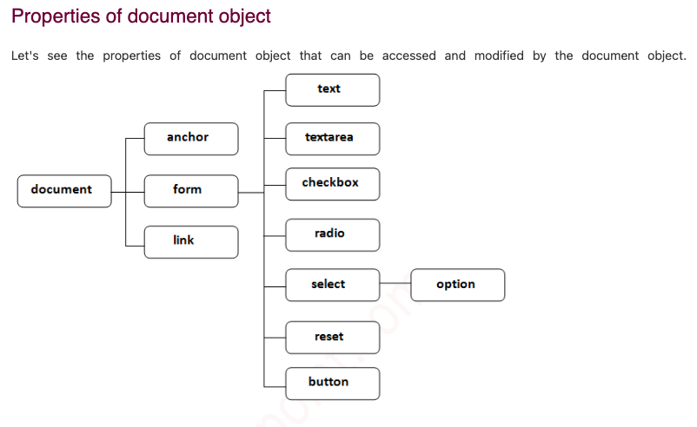

Slide 4
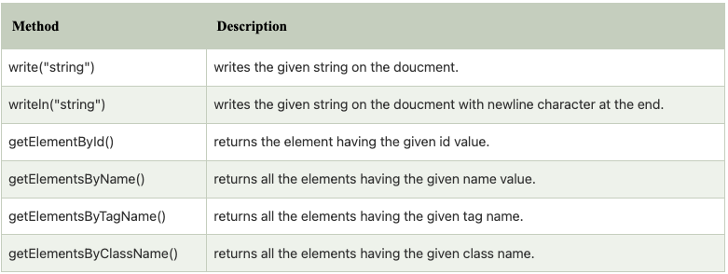
Methods of document object
We can access and change the contents of document by its methods.
The important methods of document object are as follows:

Slide 5
Accessing field value by document object
In this example, we are going to get the value of input text by user. Here, we are using document.form1.name.value to get the value of name field.
Here, document is the root element that represents the html document.
form1 is the name of the form.
name is the attribute name of the input text.
value is the property, that returns the value of the input text.

Slide 6
Let's see the simple example of document object that prints name with welcome message.
<script type="text/javascript">
function printvalue()
{
var name=document.form1.name.value;
alert("Welcome: "+name);
}
</script>
<form name="form1">
Enter Name:<input type="text" name="name"/>
<input type="button" onclick="printvalue()" value="print name"/>
</form>

Slide 7
Javascript - document.getElementById() method
The document.getElementById() method returns the element of specified id.
In the previous page, we have used document.form1.name.value to get the value of the input value. Instead of this, we can use document.getElementById() method to get value of the input text. But we need to define id for the input field.

Slide 8
Let's see the simple example of document.getElementById() method that prints cube of the given number:
<script type="text/javascript">
function getcube(){
var number=document.getElementById("number").value;
alert(number*number*number);
}
</script>
<form>
Enter No:<input type="text" id="number" name="number"/><br/>
<input type="button" value="cube" onclick="getcube()"/>
</form>

Slide 9
GetElementsByClassName()
The getElementsByClassName() method is used for selecting or getting the elements through their class name value.
This DOM method returns an array-like object that consists of all the elements having the specified classname.
On calling the getElementsByClassName() method on any particular element, it will search the whole document and will return only those elements which match the specified or given class name.
Syntax:
var ele=document.getELementsByClassName('name');

